Slide 1
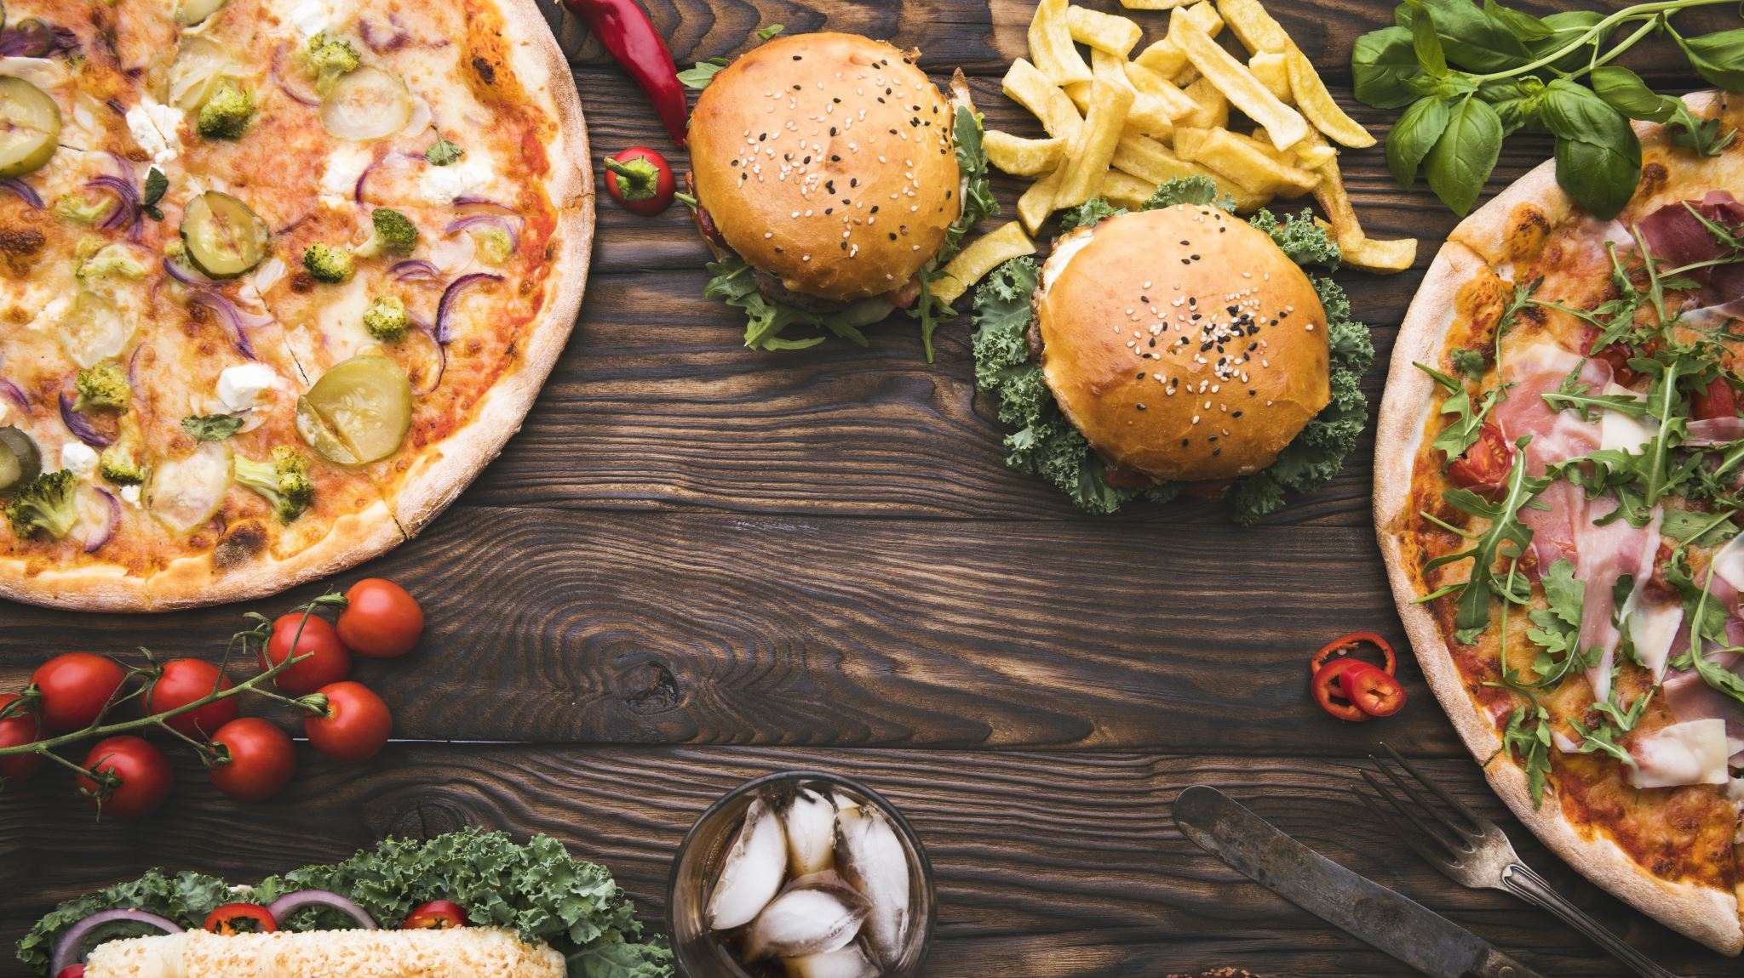
Eat&Meet
Netanel Tzadok, David Bretler.

Slide 2
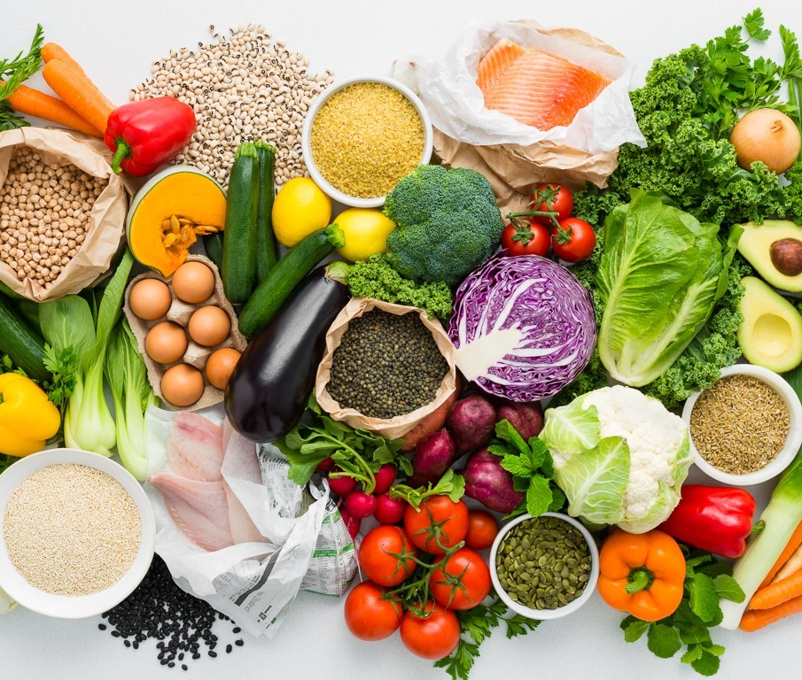
Problem:
You don’t know what you can make with your ing.
You don’t have enough ing. to make great meal.

Slide 3
Solution:
Find recipes by ingredients
Find other users in your area for shared meal

Slide 4


Slide 5

Some tech…
Firebase.
NGROK.
Python libraries as geopy, request and so on.

Slide 6
Challenges:
No useable API for recipes.
Selenium quite slow.
Solution as mentioned – DB.

Slide 7

Questions ?

